Slide 1

CSCE 121 Introduction to Program Design & Concepts
File I/O
Dr. Tim McGuire
Grateful acknowledgment to Dr. Philip Ritchey and Dr. Michael Moore for some of the material on which these slides are based.

Slide 2
File Operations
File: a set of data stored on a computer, often on a disk drive
Programs can read from, write to files
Used in many applications:
Word processing
Databases
Spreadsheets
Compilers

Slide 3
Using Files for Data Storage
Can use files instead of keyboard, monitor screen for program input, output
Allows data to be retained between program runs
Steps:
Open the file
Use the file (read from, write to, or both)
Close the file

Slide 4
General Process
Open File
Check that file opened successfully
Use file (i.e. read/write)
Close File

Slide 5
Using Files
Requires fstream header file
use ifstream data type for input files
use ofstream data type for output files
use fstream data type for both input, output files
Can use >>, << to read from, write to a file
Can use eof member function to test for end of input file

Slide 6
Files: What is Needed
Use fstream header file for file access
File stream types:
ifstream for input from a file
ofstream for output to a file
fstream for input from or output to a file
Define file stream objects:
ifstream infile;
ofstream outfile;

Slide 7
Default File Open Modes
ifstream:
open for input only
file cannot be written to
open fails if file does not exist
ofstream:
open for output only
file cannot be read from
file created if no file exists
file contents erased if file exists

Slide 8
RAII
Resource Acquisition is Initialization (RAII)
Preferred way of interacting with objects in C++
More on this later when we create our own objects that use dynamic memory.
Prefer to let objects get resources (e.g. open a file) during its initialization.
Prefer to let objects dispose of resources (e.g. close a file) during its destruction.
Automatically happens for objects created in a function.

Slide 9
RAII with File Streams
RAII approach
used in Stroustroup
Declare/define file stream and let initialization open file stream.
Check if file opened successfully.
Use file stream. (i.e. read/write)
Implicitly close file. i.e. Do nothing and let the file close when the object is destroyed.
zyBooks approach
Declare/define file stream.
Explicitly open file stream.
Check if file opened successfully.
Use file stream. (i.e. read/write)
Explicitly close file stream.

Slide 10
Code differences
zyBooks
ifstream infs;
infs.open(″filename.txt″);
if (infs.is_open()) {
// use file
infs.close();
}
RAII
ifstream infs(″filename.txt″);
if (infs.is_open()) {
// use file
}
// closes automatically
Must #include <fstream>

Slide 11
Sometimes you still need old fashioned way…
Maybe you are running a program that opens multiple files inside a loop
Before Loop begins, declare/define file stream.
Inside loop
Open file
Check if it opened successfully
Use file
Close file
Note that here, open/close happens multiple times for the same file stream object

Slide 12
Letting the User Specify a Filename
In many cases, you will want the user to specify the name of a file for the program to open.
Starting with C++ 11, you can now pass a string object as an argument to a file stream object’s open member function.
(Prior to this you had to pass a C-style null-terminated string)
String literals are stored in memory as null-terminated C-strings, but string objects are not.

Slide 13
fileopen.cpp
// This program lets the user enter a filename.
#include <iostream>
#include <string>
#include <fstream>
using namespace std;
int main()
{
ifstream inputFile;
string filename;
int number;
// Get the filename from the user.
cout << "Enter the filename: ";
cin >> filename;
// Open the file.
inputFile.open(filename);
// If the file successfully opened, process it.
if (inputFile)
{
// Read the numbers from the file and
// display them.
while (inputFile >> number)
{
cout << number << endl;
}
// Close the file.
inputFile.close();
}
else
{
// Display an error message.
cout << "Error opening the file.\n";
}
return 0;
}

Slide 14
See fileopen.cpp, fileopenRAII.cpp, fileopen-exceptions.cpp

Slide 15
Stream States
CSCE 121
Based on slides created by Carlos Soto.

Slide 16
Stream State
State refers to the overall configuration of information.
When you change a variable’s value, you change the state
This may or may not affect a future step of the computation, but it probably does (otherwise, what is the point of the variable?)

Slide 17
What is the state of a stream?
Good
Location in file
End of File
Bad
Problems with the stream itself
Internet goes down
Printer loses power
Any kind of crash or break
Input is not what is expected (Logical)
expected type A, got (incompatible) type B

Slide 18
Robustness
Recall that we want our programs to be robust.
i.e. they should not crash on unexpected input!
Streams store state information in flags (i.e. bits)
We can use stream state information to recover gracefully when there are problems with streams.

Slide 19
Stream State Flags
Flag | Meaning
goodbit | Everything is OK
eofbit | Reached end of a file
badbit | Something is wrong with stream
failbit | Stream used incorrectly
http://www.cplusplus.com/reference/ios/ios_base/iostate/

Slide 20

Stream State Functions
Function | eofbit | failbit | badbit
good()
eof()
bad()
fail()
none of the bits set i.e. zero
Notes:
When a stream (e.g. cin) is in an error state, all requests for input will be ignored.

Slide 21
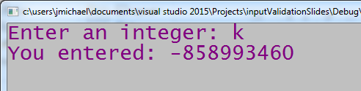
Using Stream State to Validate Input
cout << "Enter an integer: ";
int val;
cin >> val;
cout << "You entered: " << val << endl;
Failbit is set.
So, we can catch this and ask until we get a number.

Slide 22
Using Stream State to Validate Input
cout << "Enter an integer: ";
int val;
cin >> val;
while(!cin.good()) { // any of the stream state bits is set
cin.clear(); // set all stream state bits to zero, buffer NOT cleared
cin.ignore(numeric_limits<streamsize>::max(), '\n');
// clear the buffer of everything, i.e. make clean slate for input
cout << "Enter a valid integer: ";
cin >> val;
}
cout << "You entered: " << val << endl;

Slide 23
Checking for errors in our input
cin.clear();
Clear stream states
Does NOT affect buffer (so whatever caused problem is still in the buffer)
cin.ignore(numeric_limits<streamsize>::max(), '\n');
First parameter – max number of characters to ignore (i.e. remove from buffer)
Second parameter – character to stop ignoring characters if found before max number of characters removed from buffer
If ignore() is called with no arguments, cin will only skip the very next character
numeric_limits – different streams have different sizes, using this ensures that if the buffer is completely full, it will remove all of it.
‘\n' – character representing end of line.
#include <limits> to use numeric_limits
See validate.cpp

Slide 24
More on File Objects

Slide 25
fstream Object
fstream object can be used for either input or output
Must specify mode on the open statement
Sample modes:
ios::in – input
ios::out – output
Can be combined on open call:
dFile.open("class.txt", ios::in | ios::out);
An alternative to using the open member function is to use the file stream object definition to open the file:
fstream dFile("class.txt", ios::in | ios::out);

Slide 26
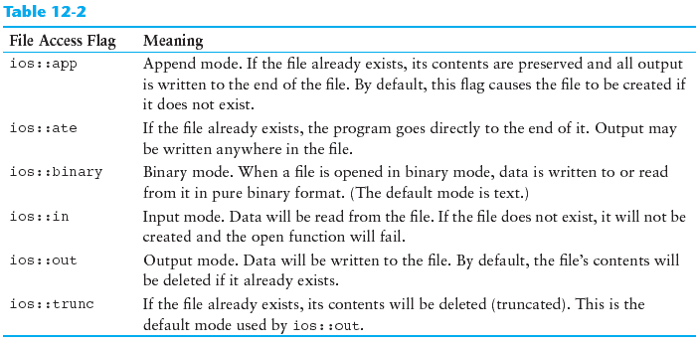
File Access Flags
Source: Gaddis, 6th edition

Slide 27
Using Files - Example
// copy 10 numbers between files
// open the files
fstream infile("input.txt", ios::in);
fstream outfile("output.txt", ios::out);
int num;
for (int i = 1; i <= 10; i++)
{
infile >> num; // use the files
outfile << num;
}
infile.close(); // close the files
outfile.close();

Slide 28
Default File Open Modes
ifstream:
open for input only
file cannot be written to
open fails if file does not exist
ofstream:
open for output only
file cannot be read from
file created if no file exists
file contents erased if file exists

Slide 29
More File Open Details
Can use filename, flags in definition:
ifstream gradeList("grades.txt");
File stream object set to 0 (false) if open failed:
if (!gradeList) ...
Can also check fail member function to detect file open error:
if (gradeList.fail()) ...

Slide 30
See streamstates.cpp

